Slide 1

Texas Freight & Rail Studies
Mark Werner, P.E.
Transportation Planning & Programming
Multimodal Section

Slide 2
Statewide Freight Studies
Development of statewide need assessment for freight movement
Evaluation of freight movements and operations within specific areas
Identification of opportunities to increase freight efficiencies
Feasibility of relocating freight infrastructure and operations to alternative alignments

Slide 3
Statewide Freight Studies
Identification and analysis of potential freight connections to Trans Texas Corridor
Development of recommendations and plans to implement identified projects
Other tasks associated with potential projects for improving freight movements

Slide 4
Three Phase Studies
Phase 1 – Information Gathering
Phase 2 – Alternative Analysis and Evaluation
Phase 3 – Economic Development and Prioritization of Recommendations

Slide 5
Current Studies
San Antonio
Houston
West Texas – Amarillo, Lubbock & Odessa Districts
East Texas – Paris, Atlanta, Tyler, Lufkin & Dallas Districts

Slide 6

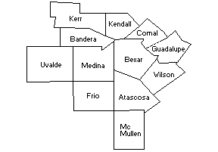
San Antonio Region Study Area
TxDOT’s 12 County San Antonio District
  Kerr - Atascosa
  Kendall - Wilson
  Bandera - Bexar
  Uvalde - Comal
  Medina - Guadalupe
  Frio - McMullen

Slide 7
Inventory of Existing Rail Network
571 miles of railroad tracks
  420 single track mainline miles
  80 double track mainline miles
  32 miles of yard tracks
    excluding SoSan, East, and Kirby yards
  40 miles of siding or industrial spur tracks
Nearly 48,000 lineal feet (over 9 miles) of railroad structures
895 grade crossings
  326 other signs or signals
  320 other gates
  131 stop signs
  107 crossbucks
  9 flashing lights
  2 train activated bells/wigwags

Slide 8
Freight Rail Movement Constraints
Connectivity between existing rail lines
Capacity increase limitations
  Along the mainline
  Rail yards
Curves
Roadway/Rail interface

Slide 9
Measuring Railroad Capacity
Develop statistical models
Observe volume of traffic over a particular route segment
Observe volume of traffic over the entire rail network under consideration
Assess terminal capacity
  Provides an entirely different set of challenges
    Institutional challenges
    Operational constraints

Slide 10
Measuring Railroad Capacity
Evaluate the physical characteristics of the terminal location
Identify potential bottlenecks
Establish “base-case” operational model
Establish railroad considerations for growth forecasts
  Requirements to handle the additional traffic
  Evaluate the commodity mix
  Assess current potential capacities of both private and publicly owned transload facilities

Slide 11
Rail Tonnage - 2004
Over 98 Million Gross Tons (MGT) of freight via rail came into San Antonio
  Approximately 1.2 Million rail cars, and approximately 56 Million tons of freight
    Over 3300 cars/day average
Over 95 MGT of freight via rail left San Antonio
  Over 1.17 Million rail cars and over 54 Million tons of freight
    Over 3200 cars/day average

Slide 12
San Antonio Bypass Study Characteristics
Numerous conceptual corridors are being analyzed for bypassing San Antonio
  Between 66 and 90 mile overall lengths
    Existing route approximately 65 miles
Bypassing municipalities
  Seguin
  Marion
Rail yard locations included
  Crew change points
  In-line fueling facilities
  Local service concerns
Connectivity to existing rail lines
  Austin Sub @ New Braunfels
  Corpus Christi and Laredo Subdivisions
    Toyota

Slide 13
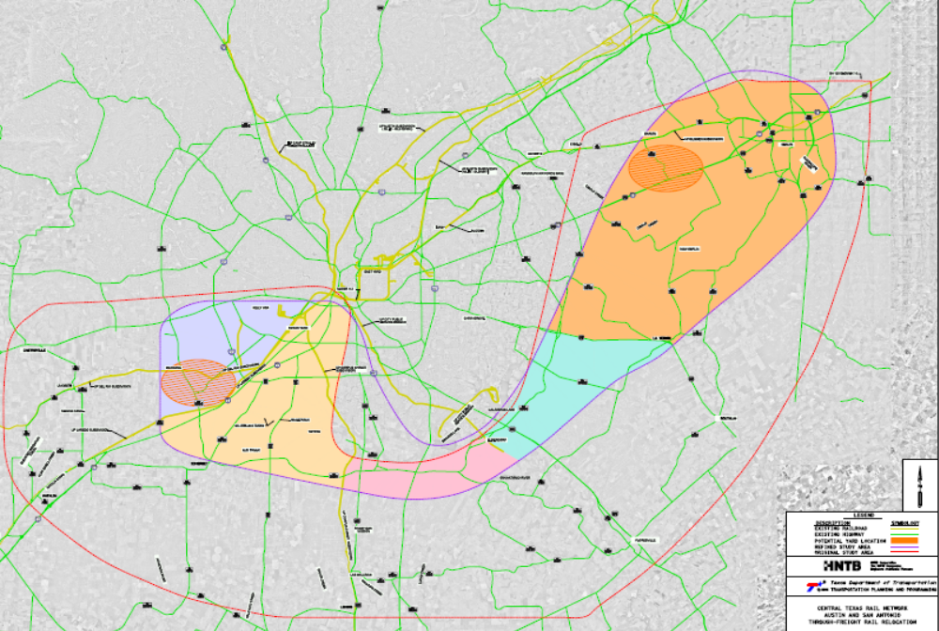
Refined Study Area

Slide 14
Next Steps
Develop and perform iterations to determine benefits of:
  Infrastructure improvements
  Yard relocation considerations
  Rail corridor consolidations
  Rail corridor alternatives
  Combinations thereof
Establish cost/benefit ratios
Establish public benefit as well as private benefit

Slide 15
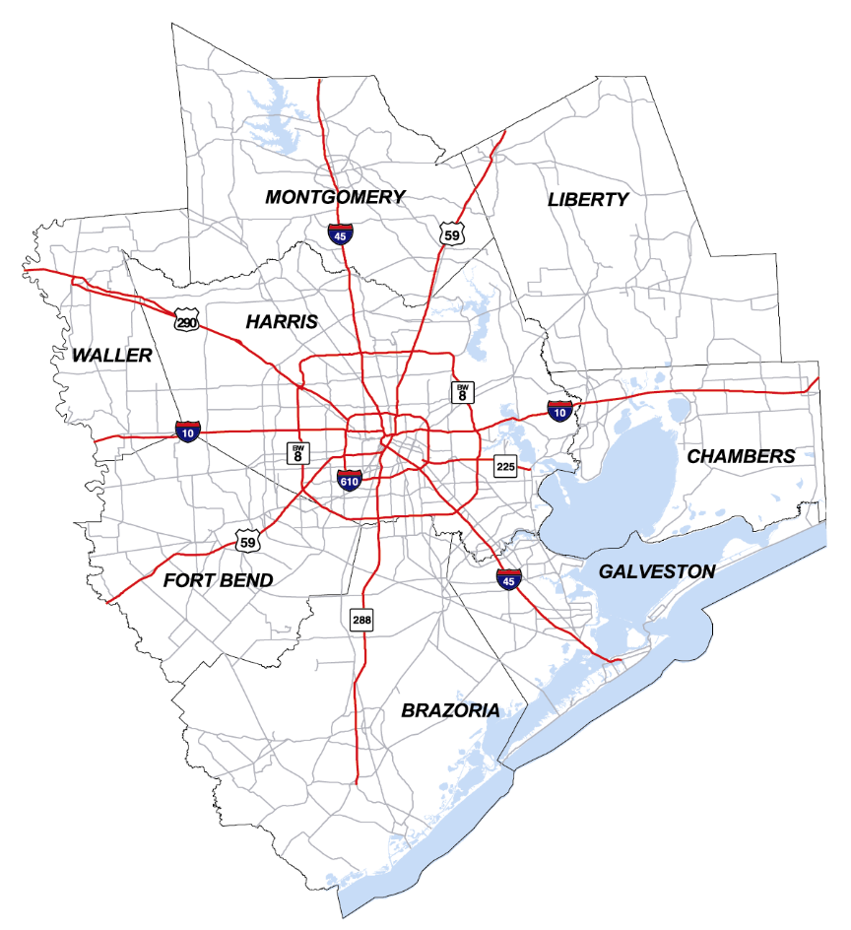
Houston Study Area
TxDOT’s 6 County
Houston District
  Harris
  Montgomery
  Waller
  Fort Bend
  Brazoria
  Galveston
2 TxDOT Beaumont
District Counties
  Chambers
  Liberty

Slide 16
Inventory of Existing Rail Network
1135 miles of railroad tracks
  830 single track mainline miles
  75 double track mainline miles
  70 miles of yard tracks
    excluding the Major yards
  159 miles of siding or industrial spur tracks
Nearly 113,000 lineal feet (over 21 miles) of railroad structures
1203 grade crossings
  574 other signs or signals
  308 other gates
  145 stop signs
  145 crossbucks
  31 flashing lights

Slide 17
Rail Freight Movements
Over 118 Million Gross Tons (MGT) of freight via rail came into Houston
  Approximately 1.45 Million rail cars, and over 67 Million tons of freight
    Just under 4000 cars/day average
Over 127 MGT of freight via rail left Houston
  Approximately 1.56 Million rail cars and over 72 Million tons of freight
    Nearly 4300 cars/day average

Slide 18
Rail Freight Movements
Over 217 MGT of freight via rail moved around “inside” of Houston
  Annually, that’s nearly 2.67 Million rail cars and over 123 Million tons of freight
Approximately 28 MGT of freight rail stayed in Houston
  Annually, nearly 346,000 rail cars and over 16 Million tons of freight

Slide 19
Addressing Capacity Improvements
Must be made to handle predicted increases in tons of freight hauled
Must make sense operationally, especially for the Railroads
Must be ranked in order of cost/benefit ratio
Must be made to sustain growth

Slide 20
Railroad Capacity Improvements
Must be operationally and financially sound
Will investigate previously recommended improvements as alternatives
Will use Rail Traffic Controller (RTC) modeling
  Establish base (current) network
  Develop alternative alignments/upgrades
    Test validity
    Determine cost/benefit ratios

Slide 21
RTC Modeling
Over 2000 train files coded
Trains go “to” Houston.
  RR’s are not running a bunch of trains “through” Houston
Very small percentages of trains are intermodal
Very large percentages of trains are local
  UP has over 900 customers in Region

Slide 22
Application of RTC
Analyze effects of capital projects, such as:
  sidings, crossovers and bypass tracks
  double tracking
  new locomotives by type
Determine best time to schedule trains
Determine effects of adding and deleting train service
Determine comparisons of improving existing infrastructure vs. alternative alignments
  Key component in validating operational improvements

Slide 23
Rail Network Improvement Analysis
Review alternative routes
Analyze operational changes
Review rail yard capacities
Investigate at-grade crossings for
  Closures
  Separations
Provide cost/benefit per recommendation assumptions
    RR validation on assumptions required

Slide 24
Next Steps
Analyze vs. Base Case
  Determine effectiveness of improvements
  Establish cost/benefit ranking
Define for near term, mid-range, and long term applicability

Slide 25
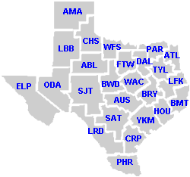
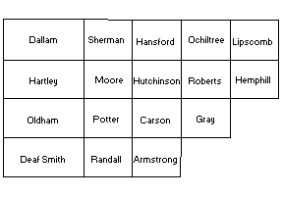
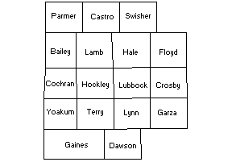
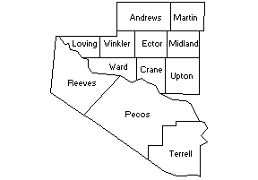
West Texas
Amarillo District
Lubbock District
Odessa
District

Slide 26
Getting Started
Notice to Proceed issued April 16, 2006
Public Meetings
Identifying Stakeholders
Developed Questionnaires that have been sent to stakeholders
Begun establishing an inventory of the existing freight rail system

Slide 27
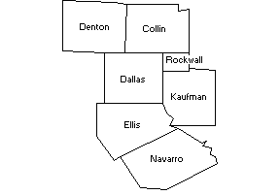
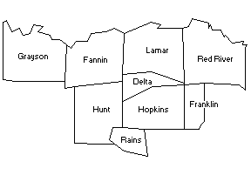
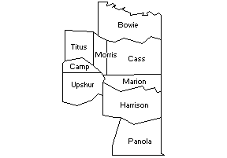
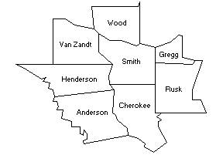
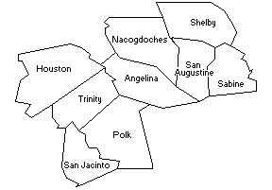
East Texas
Paris District
Dallas District
Atlanta
District
Tyler District
Lufkin District

Slide 28
Getting Started
Notice to Proceed Issued May 30, 2006
Public Meetings
Identification of Stakeholders

Slide 29
Future Studies
Dallas Fort Worth
  Area wide freight will be coordinated with the North Central Texas Council of Governments Tower 55 study
Border Area

Slide 30
Questions

